Slide 1
Getting started with remote teaching
Evan Dickerson, SFHEA
March 2020

Slide 2
Overview - contents
One location for ELU and QM Academy help
Pedagogic considerations
Planning to take your teaching online
Clear instructions matter online
Assessment considerations
Self-help guides available
Experiences of TNE colleagues
ELU and QM Academy staff development
Further advice and guidance
Contact ELU and QM Academy
Notes:
In potential contrast with previous and current ‘patchwork solution’

Slide 3
One location to find help online
This presentation provides an overview of the help available from ELU and QM Academy that is listed on this webpage:
https://elearning.qmul.ac.uk/announcements/remote-teaching-at-qmul/
This page will be updated regularly to keep pace with current events with advice and support, so check it to keep informed of support and training from the E-Learning Unit and QM Academy
Notes:
In potential contrast with previous and current ‘patchwork solution’

Slide 4
Pedagogic considerations
Don’t just put materials online and hope for the best, consider the pedagogy first.
Focus on the weekly learning outcomes: state these clearly online
Build a logical structure (scaffold) for each week
Within this, there could be a mixture of activities:
Reading lists Watching Q-Review lectures / other videos Quizzes
Synchronous delivery Asynchronous work Discussion / online collaboration
Notes:
In potential contrast with previous and current ‘patchwork solution’

Slide 5
Planning to take your teaching online
Before putting all the content you have online – think!
Work with technologies (QMplus; Q-Review etc) that you are familiar with
You should have plan what you need to help students learn
To make this easier, tackle a week at a time
Organise what you want to have online into priority categories:
Essential to have Supplementary materials
Materials I have Materials I can find / curate I need to create
Notes:
In potential contrast with previous and current ‘patchwork solution’

Slide 6
Clear instructions matter online
Instructions matter because this will tell students:
What you want them to do
Why you want them to engage with the materials you provide
Without instructions, they won’t understand what they should do, in what order and why you want them to do things
A list of links without a structure or contextual information will just seem like a random list, whereas if there is a rationale behind it students will be more likely to engage because they know why they should.
Keep the language used clear, concise and consistent.
Notes:
In potential contrast with previous and current ‘patchwork solution’

Slide 7
Assessment considerations
Knowing that students have met their learning outcomes is important, so consider how you will assess this.
Guidance will be forthcoming on formal assessments in due course
Consider now how you will incorporate elements of low stakes formative assessments into what you ask students to engage with
This could include:
MCQs; responding to discussion board threads; keeping an online reflective journal
Notes:
In potential contrast with previous and current ‘patchwork solution’

Slide 8
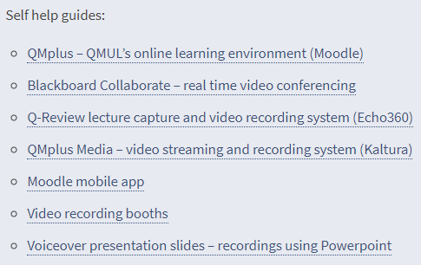
Guides available
The web page contains links to several e-learning guides:
Notes:
In potential contrast with previous and current ‘patchwork solution’

Slide 9
Experiences of TNE colleagues
There are several resources available detailing the experience of colleagues who have delivered teaching to China
These will help give you an indication of some of the many factors they considered and the approaches they took in moving modules to online delivery
Further documents and presentations may be added
Notes:
In potential contrast with previous and current ‘patchwork solution’

Slide 10
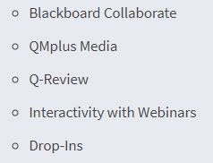
ELU and QM Academy staff development
A weekly programme of online staff development is offered and will develop as the situation arises, so check the web page for updates. Join via the links on the web page.
In the week beginning 16 March, this includes:
Notes:
In potential contrast with previous and current ‘patchwork solution’

Slide 11
Further advice and guidance
ELU and QM Academy will curate advice and guidance from external sources that should help you get ready to deliver remote teaching and work effectively from home.
We have included materials so far from Jisc and Advance HE
Notes:
In potential contrast with previous and current ‘patchwork solution’

Slide 12
Contact ELU and QM Academy
If you need to raise a ticket for ELU technical support do this via the usual helpdesk
For all other support from ELU or QM Academy please email
elearning@qmul.ac.uk
An appropriate member of the teams will respond asap
Notes:
In potential contrast with previous and current ‘patchwork solution’

