Slide 1
Interactivity in webinars
QM Academy team
Welcome! As you log in, please introduce yourself using the chat (right hand side of the screen): your name, department and what type of teaching you are moving online

Slide 2
Aims for this webinar
Share our experience of online teaching
Encourage you (if you are able) to integrate interactivity into webinars
Show you a range of tools for this
Support you with ideas for specific challenges you are facing and enable sharing of ideas and good practice
Enable you to experience the webinars from a student perspective

Slide 3
Webinar ground rules for students?
Throughout this webinar you will be asked to engage in the following ways through
    Voting in polls
    Written discussion by entering text in the chat area
    Talking in discussion groups
    Entering text on slides / virtual whiteboard
Note
  You must engage with all activities to be marked as attended
  You do not need to know all the answers, you may answer that you do not know or select NA in polls
  Please note that all chat is automatically recorded – even private chat

Slide 4
Poll
How much online teaching experience do you have?
Please post in the chat throughout the session to react, express any concerns you have, share relevant information, or raise any questions – we will use this to help inform guidance documents

Slide 5
Practical advice for your students
Keep mics muted when not speaking
Use headphones
If connection is poor switch to voice only
Use Google Chrome on a PC/tablet – not a phone!
Use ‘raise hands’ to signal you want to talk?

Slide 6
Practical advice on presenting and delivery
Use audio and video?
Leave longer silences than in face to face teaching
Quiet time for students to think / work individually is ok
You may need to take more active role in moderating discussions
BBC converts PPT into images which are shared (animations etc don’t work)
Keep it friendly and personal – ice breaker around where people are logging in from / pets?!

Slide 7
Moving teaching online – key starting points
Do what works for you – keep it simple
Research shows active learning and interactivity in online teaching enhances learning**
Active learning and interactivity can be synchronous or asynchronous
Start with your ILOs – how can students achieve these online?
How can we activate the social side of learning online?
**See for example Durrington et al, 2006; Croxton, 2014; Kent et al, 2016; Dailey-Hebert, 2018

Slide 8
Synchronous | Asynchronous
Advantages: immediate personal engagement (sense of community) you can: take questions, encourage discussion, create discussions and breakout groups link out to other online resources sessions can be recorded for revision /those who can’t attend | Advantages: Useful if staff/students are facing difficult circumstances at home (e.g. no private spaces, caring responsibilities) no need to use video or live face-to-face students manage their time and tasks (work at their own pace) more time to engage with and explore the course material

Slide 9
Synchronous | Asynchronous
Disadvantages: requires decent internet connection students may experience technical challenges or difficulties | Disadvantages: - students may feel less personally exchanged and less satisfied without the social interaction (peers and lecturers) - course material and tasks may be misunderstood by students

Slide 10
Combining synchronous and asynchronous ​
A combination approach may be best… Save webinars for most discursive topics, or those where you wish to test / give feedback to students in real time ​ For other elements of the course use asynchronous activities ​ Asynchronous can work as pre-webinar preparation or post-webinar activities ​ Can you provide an asynchronous alternative to participation in a webinar for those who may be working from a different time zone or not have access to a suitable study space for webinar participation? ​ You might also need a backup plan in case of service outage

Slide 11
Online lectures: tools for interactivity
Student response systems – chunking/breaking up lecture / start & end
Quiz integrated into Blackboard
Polls
Show of hands
Chat
Sharing screen – videos etc

Slide 12
Please navigate to kahoot.it
Students can do this using their mobile or the same device as they are viewing the webinar (opening a different tab)

Slide 13
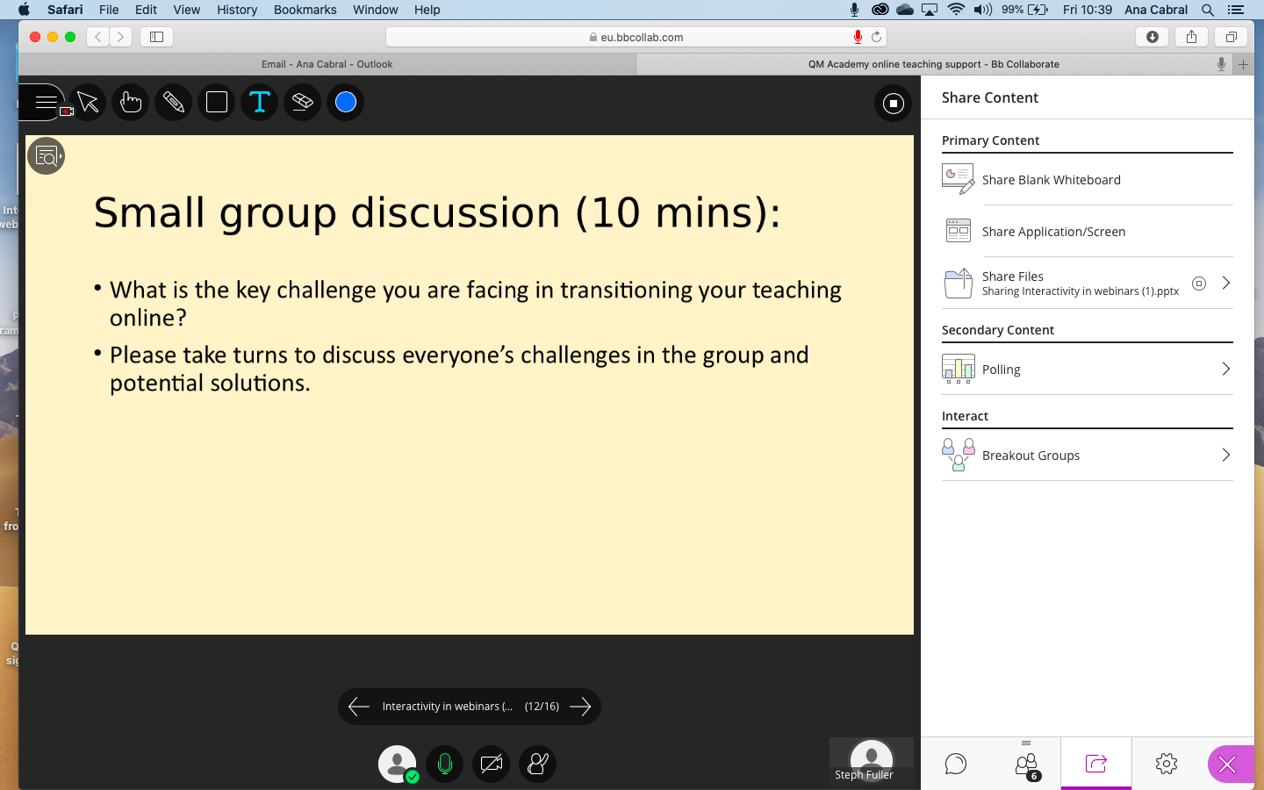
Screenshot: moderator view of sharing content

Slide 14
Raise hands: do you plan to include an active learning element in your online lectures?
Will you use a pre-recorded lecture and asynchronous materials?

Slide 15
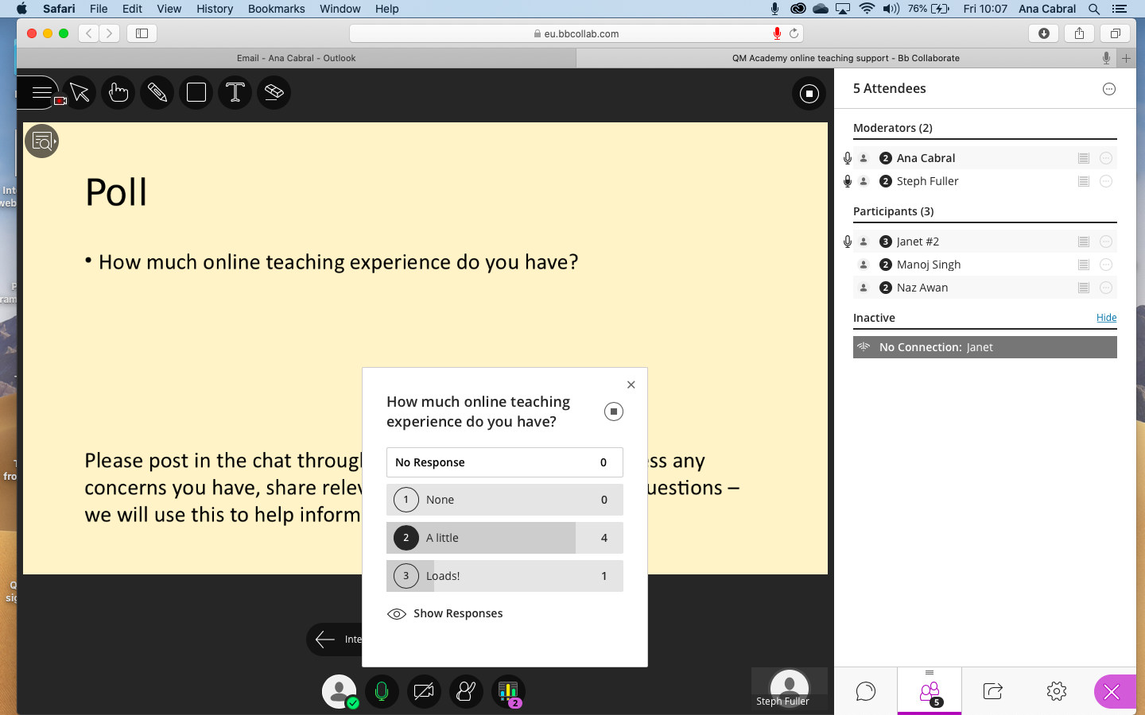
Screenshots – moderator view poll

Slide 16
Online seminars: tools for interactivity
Same as for lectures, plus
Breakout rooms
  Challenges: no file sharing – use googledocs etc
Google forms
  Peer feedback
  Surveys
  Evaluation
Students annotate slide/ whiteboard

Slide 17
Group brainstorm - please add text to the slide: what do you think are the challenges and potential benefits of delivering seminars online?
Challenges | Benefits

Slide 18
Small group discussion (10 mins):
What is the key challenge you are facing in transitioning your teaching online?
Please take turns to discuss everyone’s challenges in the group and potential solutions.

Slide 19
Feeding back (10 mins):
What is the key challenge you are facing in transitioning your teaching online?
Please take turns to discuss everyone’s challenges in the group and potential solutions.
Are there any ideas you want to share with the whole group – or are there any challenges remaining?

Slide 20
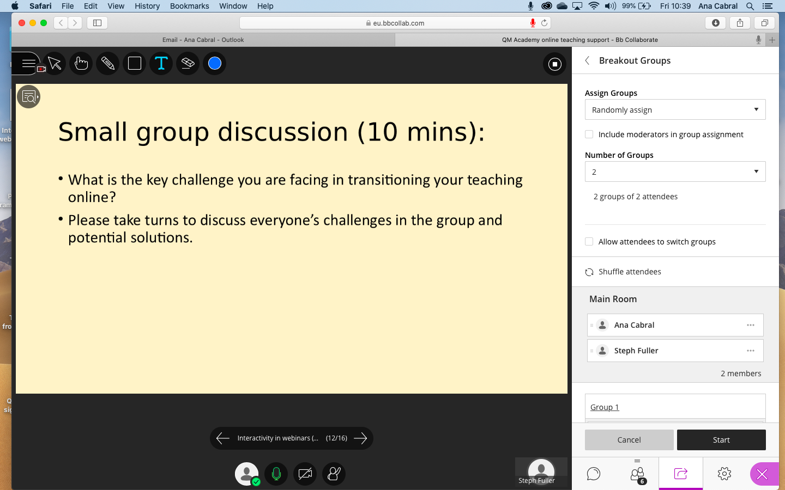
Screenshot: moderator view breakout groups

Slide 21
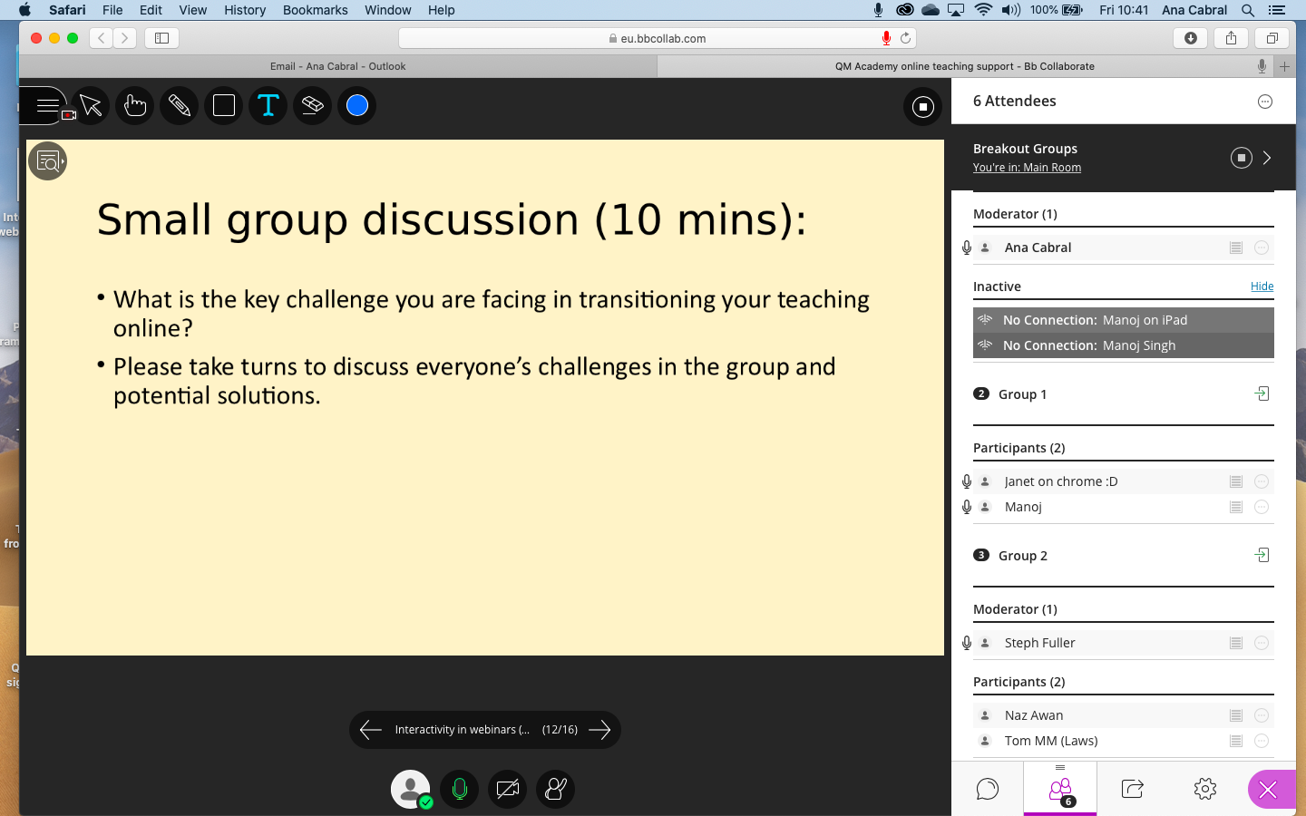
Screenshot: moderator view breakout groups 2

Slide 22
Further advice and support
QMAcademy guidance doc: interactivity for online teaching, synchronous and asynchronous
QMUL elearning unit: training, drop ins and online guides for technical support
Pittsburgh Uni guide to using groups in Blackboard Collaborate
Free online training e.g. Epigeum: moving to online
European Association of Distance Teaching Universities Coronacrisis support materials
SEDA google doc composite of resources
DCU moving swiftly online resources
#LTHEchat
Box of Broadcasts
Online icebreakers

